Slide 1
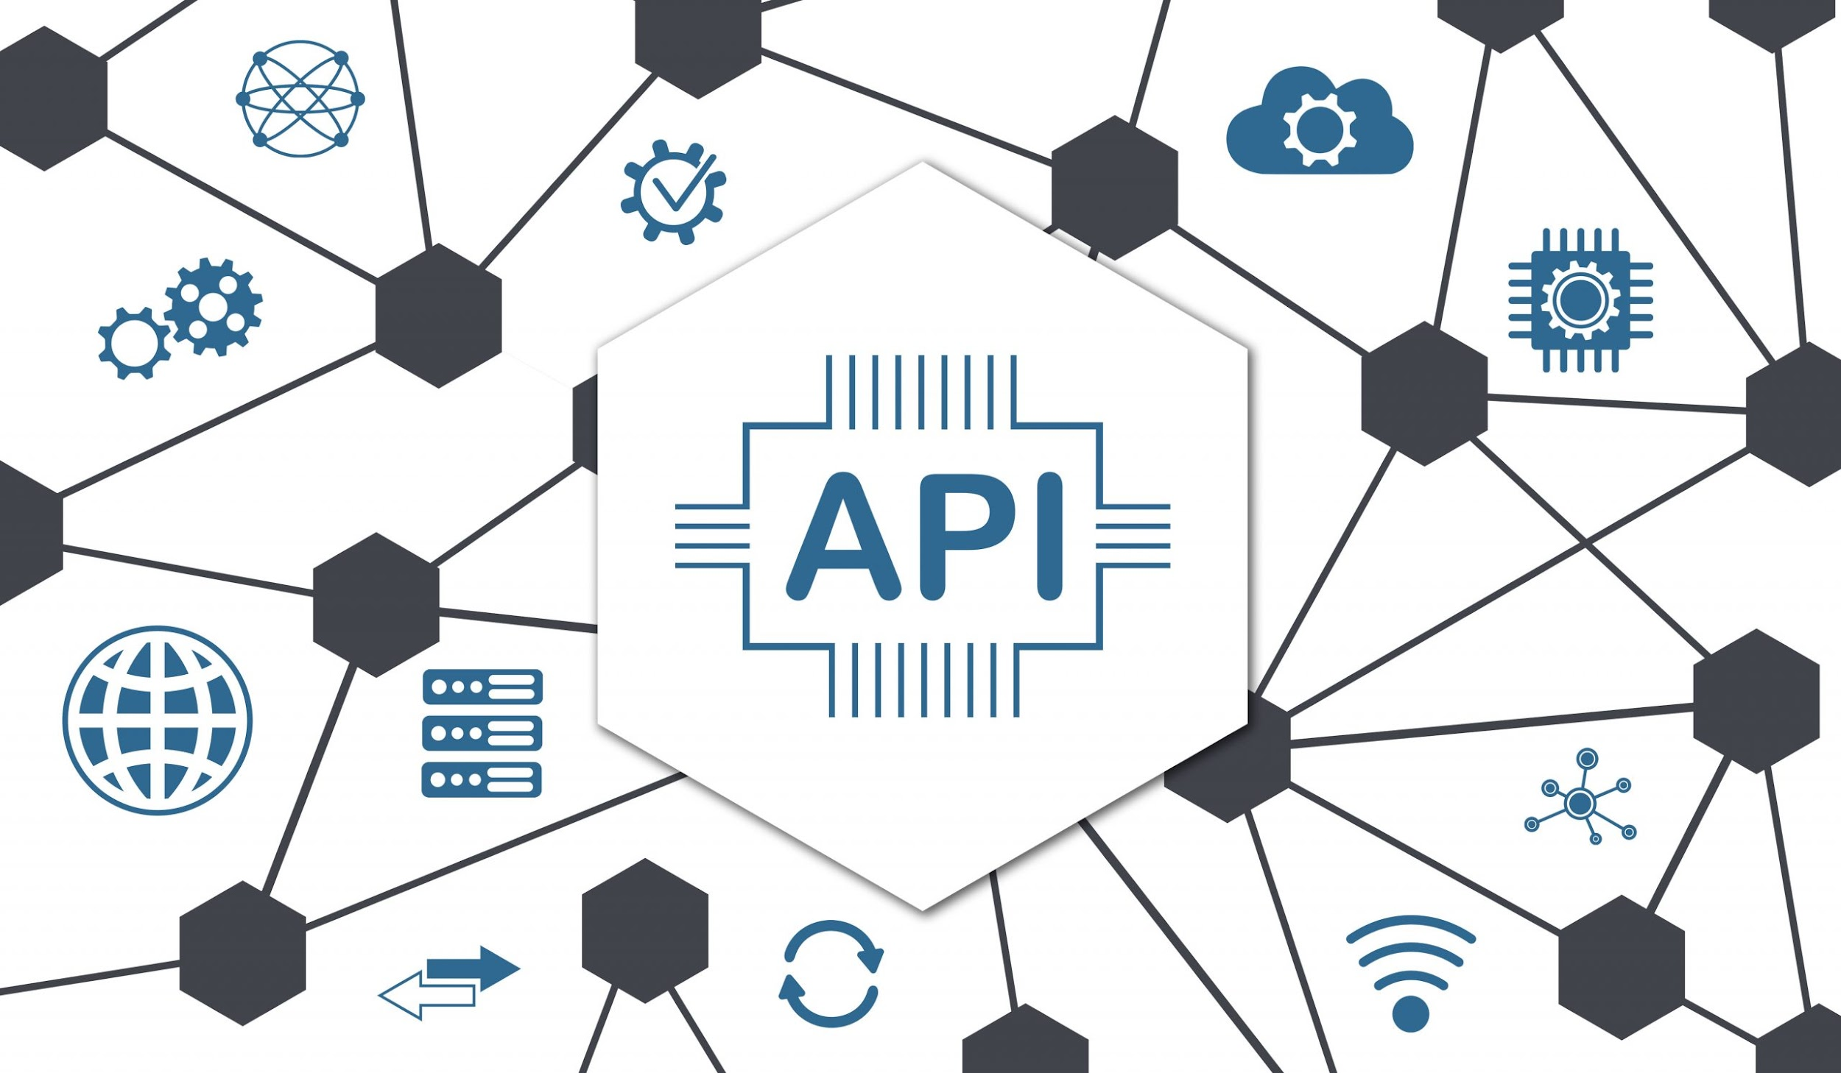

Slide 2
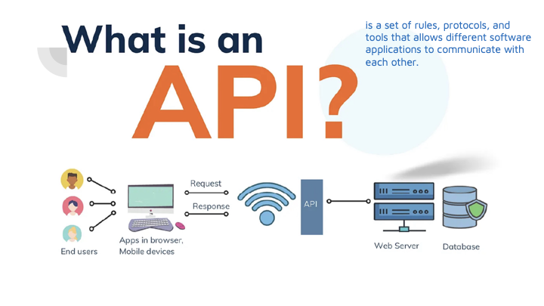

Slide 3

Key points to understand about APIs
Definition: An API (Application Programming Interface) is a set of rules and protocols that allows different software applications to communicate with each other.
Purpose: APIs enable systems to exchange data and functionality, making it possible for one program to request services or data from another without needing to understand its internal workings.
Types: There are various types of APIs, including web APIs (HTTP-based), library APIs (for programming languages), and operating system APIs (for interacting with system-level resources).
Endpoints: APIs typically expose endpoints, which are specific URLs or paths where services or data can be accessed.
Request-Response Model: APIs often operate on a request-response model, where a client sends a request to the server and the server responds with the requested data or service.

Slide 4
Key points to understand about APIs
Authentication & Security: Many APIs require authentication (e.g., API keys or OAuth tokens) to ensure that only authorized users can access the data or services.
Data Formats: APIs commonly use data formats like JSON or XML to exchange information between clients and servers.
Rate Limiting: Some APIs limit the number of requests that can be made in a certain time period to prevent overuse or abuse of the service.
REST vs. SOAP: Common architectural styles for web APIs include REST (Representational State Transfer) and SOAP (Simple Object Access Protocol), with REST being more lightweight and widely used.
Documentation: API documentation is crucial for developers to understand how to interact with the API, detailing available endpoints, request parameters, and response formats.

Slide 5
Types of APIs
Three important WebAPIs are
●Web APIs: APIs that allow web browsers to interact with various features or services, providing functionalities that can be used in web development
●Library APIs: Offer pre-written functions or routines that developers can use in their programs.
●Operating System APIs: Allow applications to interact with the operating system (e.g., accessing hardware resources).
Geolocation,
Fetch
Web Storage

Slide 6

Fetch API
The Fetch API is used to make network requests to a server.
It’s commonly used for fetching data from APIs or interacting with servers. The Fetch API is a modern, native JavaScript interface, widely supported by most browsers, that facilitates network requests in a manner similar to XMLHttpRequest. However, unlike XMLHttpRequest, Fetch utilizes Promises, offering a more efficient and readable approach that eliminates the complexity associated with callback-based handling.
Notes:
While creating a web application, it's very necessary to interact with external data, and APIs play a crucial role in doing this. The Fetch API is a modern interface available in web browsers, which enhances our ability to send HTTP requests to servers. It is designed as a more powerful and flexible successor to XMLHttpRequest, the Fetch API streamlines the process with a simpler, cleaner syntax. With the help of Promises, it offers more flexible and robust options for making server requests, which allows for better handling of asynchronous operations.

Slide 7
Web Storage API
The Web Storage API provides a way for web applications to store data locally within the user's browser, offering two main storage mechanisms: localStorage and sessionStorage.
localStorage:
Stores data persistently, meaning the data remains available even after the browser is closed and reopened.
Data is stored as key-value pairs and has no expiration time unless explicitly deleted by the developer or the user.
Typically used for saving preferences, user settings, or data that should persist across sessions.
sessionStorage:
Stores data for the duration of the page session, meaning it is cleared when the browser tab or window is closed.
Like localStorage, it stores data as key-value pairs but is more temporary and typically used for data that only needs to persist during a single session (e.g., user login states or form data across multiple pages).

Slide 8

Geolocation API
The Geolocation API allows web applications to access the geographical location of a user's device (e.g., latitude and longitude) in real time, enabling location-based services and features such as maps, navigation, and personalized content.
●When a website wants to know a user’s location, it must first ask for permission. This is done through a pop-up prompt from the browser.
●The user can choose to allow or deny access, ensuring privacy control

Slide 9
Geolocation API
After permission is granted, the API fetches the user’s location as coordinates (latitude and longitude).
The device uses different methods to get this location:
GPS (Global Positioning System): Utilizes satellite signals to pinpoint the devices location with high accuracy.
Wi-Fi: Leverage nearby Wi-Fi access points to estimate the devices location.
Cellular Networks: Uses signals from cell towers to triangulate the devices position.
IP Addresses: Infers the devices location based on its IP address.
Notes:
The Geolocation API is a web API that provides a JavaScript interface to access the user's geographical location data. A Geolocation API contains the various methods and properties that you can use to access the user's location on your website.
It detects the location of the user's using the device's GPS. The accuracy of the location depends on the accuracy of the GPS device.
As location compromises the users' privacy, it asks for permission before accessing the location. If users grant permission, websites can access the latitude, longitude, etc.

Slide 10
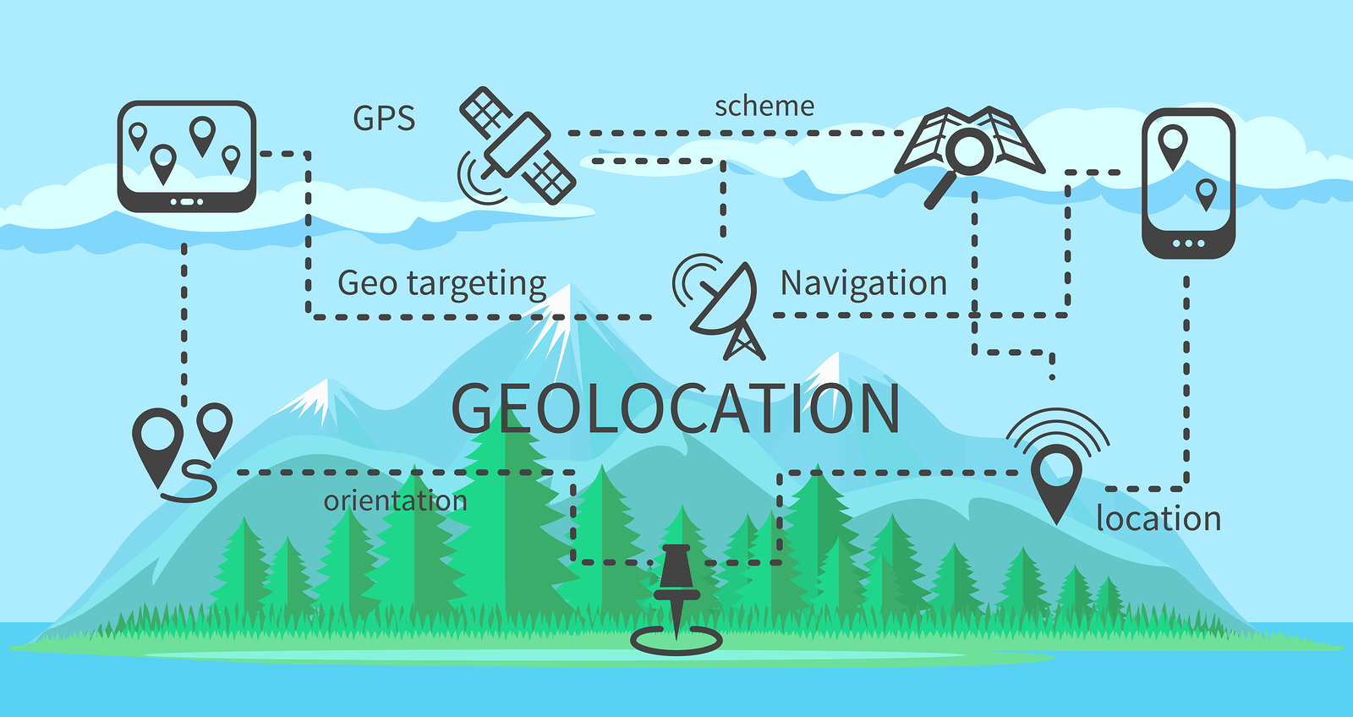

Slide 11
How It Works
Getting the Location:
The primary method is navigator.geolocation.getCurrentPosition(), which retrieves the user's current geographic position.
Tracking the Position:
You can track the user's location continuously with navigator.geolocation.watchPosition(), which returns the current location and updates it as the user moves.
Error Handling:
The API allows you to handle errors, such as when location access is denied or unavailable, using the error callback in getCurrentPosition() and watchPosition().
Options:
The Geolocation API allows customization of accuracy and update frequency through options such as enableHighAccuracy (to request more precise positioning), timeout (to specify the maximum time to wait for a response), and maximumAge (to specify how old cached data can be).
Notes:
To use the Geolocation API, you can use the 'navigator' property of the window object. The Navigator object contains the 'geolocation' property, containing the various properties and methods to manipulate the user's location.It provides the latitude, longitude, altitude, and additional information such as the speed of movement and heading.

Slide 12
Where to use the Geolocation API
Maps and Navigation Apps
Apps like Google Maps use it to show your current location, give directions, and find nearby places.
Weather Apps
Automatically shows weather forecasts for your current location.
Shopping and Restaurant Apps
Suggests nearby stores, restaurants, and deals based on where you are
Games and Augmented Reality (AR) Apps
Location-based games like Pokemon GO use it to place virtual objects in real-world locations.
Ride-Sharing and Delivery Apps
Services like Uber and food delivery apps use it to find your location for pickups or deliveries and calculate arrival times.

Slide 13
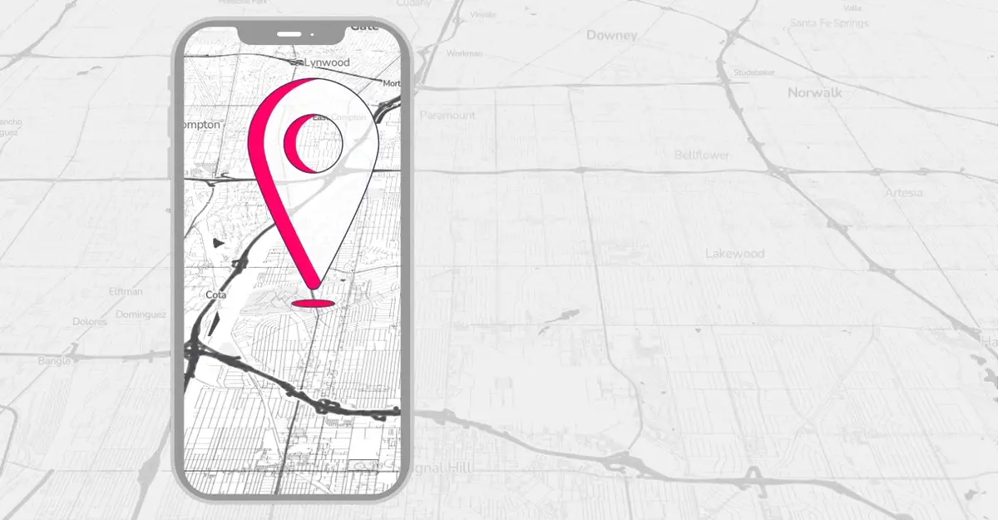
Pros and cons of Web API Geolocation
Geolocation technology offers numerous advantages for businesses.
●Improved Customer Engagement
(by offering targeted promotions and discounts)
●Valuable Insights
(help optimize their marketing strategies)
●Increased Efficiency
●Enhanced Security

Slide 14
Benefits of the geolocation API
It enhance the customer experience by personalizing the content based on their location.
●Show Accurate Product Recommendations
●Give Directions to the Nearest Branch
●Provide Information on Local Events and Promotion
●Build Brand Awareness

Slide 15
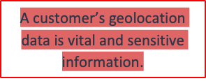
Security & Privacy Concerns
Since the geolocation API gives access to sensitive data, businesses must follow the below best practices to ensure a transparent customer experience and establish trust with their website visitors.
●Provide clear and transparent privacy policies
●Obtain explicit user consent
●Implement security measures
●Use reputable third-party providers

Slide 16
Security & Privacy Concerns
Geolocation technology raises several privacy and security risks. One of the main concerns is the potential for personal information to be tracked and used for targeted advertising or even malicious purposes.
●Use reputable third-party providers
●Comply with applicable laws
●Allow users to opt-out

Slide 17
Future Trends
Smart Cities
Increased use of smart city infrastructure, including sensors and cameras, to help improve traffic flow and reduce congestion.
Augmented Reality
Location-based AR experiences require accurate geospatial data, real-time sensor inputs, and reliable network infrastructure to seamlessly overlay digital content onto the physical world, ensuring an immersive and responsive user experience.
Location-Based Marketing
Increasing Mobile Availability in the Developing World
The rise to over one billion smartphones by 2025 offers developers a huge opportunity to create innovative location-based services for growing industries.
Autonomous Vehicles and Drone Delivery
Autonomous vehicles and drones rely on geolocation technology and points-of-interest data for precise navigation and efficient route mapping.

Slide 18


